Slide 1
Live with Autism

Slide 2

Hello!
We (Naim and Mohmoud Qawasmeh)are here to give you presentation about our project and we hope you love it.
1

Slide 3
Our objective:
Help people to discover and live with Autism
1

Slide 4
“We wish from everyone who sees our project to benefit from it ”
1

Slide 5
Autism
What is autism ? & What causes autism?
1

Slide 6
Bad practices for autism
Parents consider autism to be a disability
Parents do not know that their children suffer from autism or neglect of the disease
Wrong behavior with children with autism
1

Slide 7
How can we solve ?
First:
We did a test to check the child if he had autism.
Second:
We have provided information about autism and its causes and how to deal with this disease.
Third:
Provide with autism with hope through a presentation after the successful cases that were suffering from this disease.
1

Slide 8




How we programmed the project
1

Slide 9
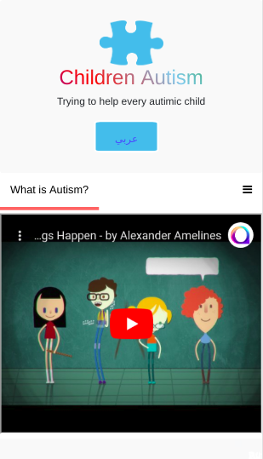
Phone project
We were designing our project to work well in the Mobile.
Place your screenshot here
<number>

Slide 10
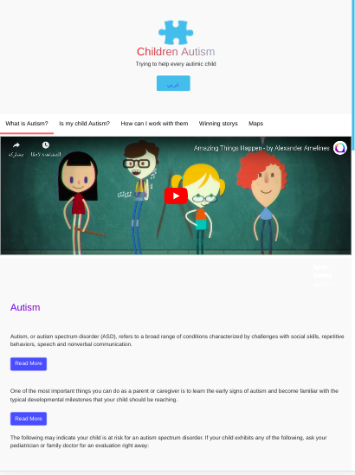
Tablet project
We were designing our project to work well in the Tablet too.
Place your screenshot here
<number>

Slide 11
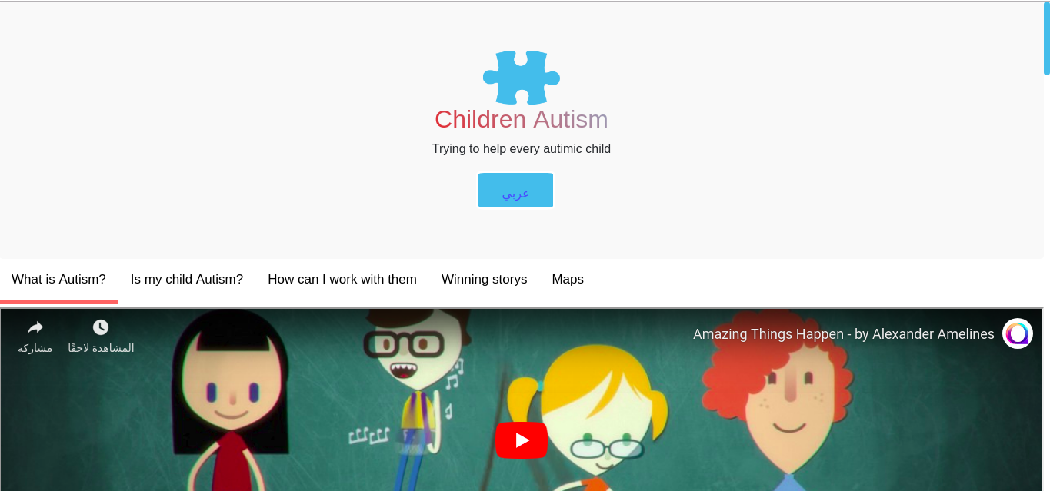
Desktop project
Our project in Desktop is being at best it is .
Place your screenshot here
<number>

Slide 12

Especial part from our project
<number>

Slide 13

Maps
our office
<number>

Slide 14

Thanks!
Any questions?
You can find us at:
qawasmy.2004@gmail.com
naeam133@gmail.com
<number>

